Slide 1

Socket Programming
Sockets are the endpoints of a bidirectional communications channel. Sockets may communicate within a process, between processes on the same machine, or between processes on different continents.

Slide 2
What is a Socket ?
Sockets are the endpoints of a bidirectional communications channel.
Sockets may be implemented over a number of different channel types: Unix domain sockets, TCP, UDP, and so on.
To create a socket, you must use the socket.socket() function available in socket module.

Slide 3
socket.socket() module
Syntax:
s=socket. socket (socket_family, socket_type, protocol=0)
Description of the parameters:
socket_family: This is either AF_UNIX or AF_INET, as explained earlier.
socket_type: This is either SOCK_STREAM or SOCK_DGRAM.
protocol: This is usually left out, defaulting to 0.

Slide 4
Server Socket Methods
Method | Description
s.bind() | This method binds address (hostname, port number pair) to socket.
s.listen() | This method sets up and start TCP listener.
s.accept() | This passively accept TCP client connection, waiting until connection arrives (blocking).

Slide 5
Client Socket Methods
Method | Description
s.connect() | This method actively initiates TCP server connection.

Slide 6
General Socket Methods
Method | Description
s.recv() | This method receives TCP message
s.send() | This method transmits TCP message
s.recvfrom() | This method receives UDP message
s.sendto() | This method transmits UDP message
s.close() | This method closes socket
socket.gethostname() | Returns the hostname.

Slide 7
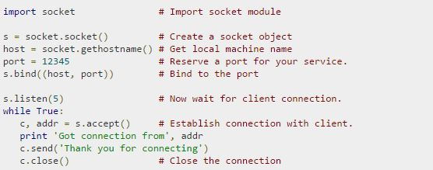
A Simple Server
To write Internet servers, we use the socket function available in socket module to create a socket object. A socket object is then used to call other functions to setup a socket server.

Slide 8
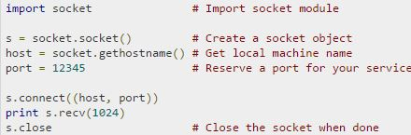
A Simple Client
The socket.connect(hosname, port ) opens a TCP connection to hostnameon the port. Once you have a socket open, you can read from it like any IO object. When done, remember to close it, as you would close a file.

